Slide 1

Spider-Man, Spider-Man, does whatever a spider can…
KARISHMA GUPTA
( CSE, 3rd year)

Slide 2



Slide 3
INTRODUCTION
Karen is an artificial intelligence user interface created by and installed in the Spider-Man suit by Tony Stark. She was designed as an aid for Spider-Man similar to J.A.R.V.I.S. and F.R.I.D.A.Y. in the Iron Man suit.
Karen was a natural-language user interface.

Slide 4
An attempt to make a very simple, Personal Assistant that understands speech as well as text input and is capable of performing tasks other than conversing. This project does not implement any sort of machine learning or language processing. Combined with a few python scripts, KAREN now performs quite a few tasks.

Slide 5
Converses, barely. USER : What’s up! KAREN : 'I am fine!’ USER : how are you? KAREN : I am nice . Rhythm box: Play USER : play music. KAREN : Okay, here is your music! Enjoy! Tells time. USER : time please. KAREN : MAM! The time is 4:30 a.m. Suggests Googling for all unrecognized interrogative questions USER : What is semiconductor KAREN : SHOW THE RESULT

Slide 6
Launches Programs. USER : open visual code KAREN : okay USER : open source code KAREN : okay USER : open my system Jarvis KAREN : okay

Slide 7


Slide 8
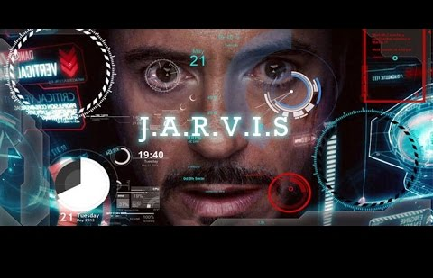

Slide 9
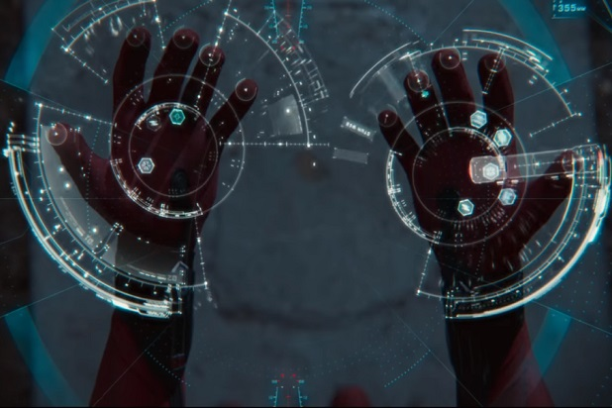
Karen displays a selection of Spider-Man's web combinations

Slide 10
FEATURES
Answering complex questions
Solving math equations
Reading social network messages
Conversing
Energy savings efficiency

Slide 11
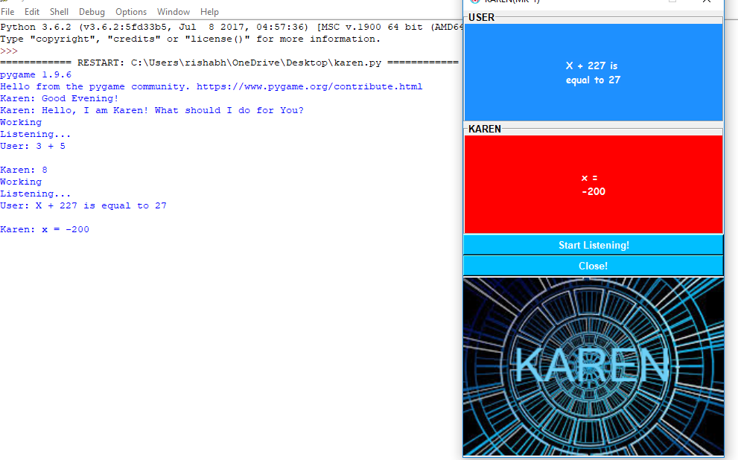
WORKING
WITH COMPLEX MATHEMATICS EQUATIONS

Slide 12
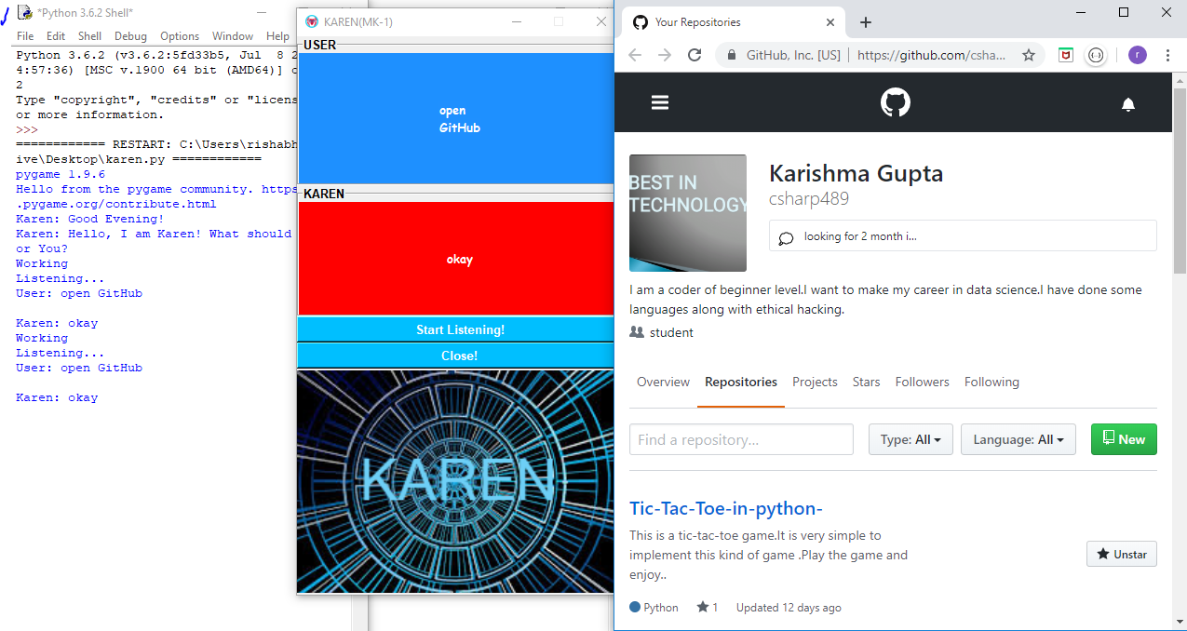

Slide 13
HOW IT WORKS?
Speak something(for e.g. “hello”)
Karen records the voice and match with available commands.
If it is available then proper response is provided.
And proper action is taken.

Slide 14
ADVANTAGES
Easy to use
Can work with variety of commands
Custom commands
Secure
Helpful for Disabled
Artificial Intelligent

Slide 15
SETUP
The necessary components for setting up KAREN are as given below:
Speech Recognition Software
Pyttsx3
Smtp lib
And many more…

Slide 16


